Slide 1
Royal Wootton Bassett Academy
Year 7 Survival Guide

Slide 2
English
At RWBA English is taken seriously as it is a core subject. At the start of the lesson, you will get 10 minutes to read a book of your choice and some students will be asked questions about the book they have just read. In English you will get a new subject to learn about every term, most of the time it will be based around a piece of influential or factual writing. During this time, you will evaluate the piece of writing and complete a task based on what you have worked on during the lesson and this is the base of most English lessons. At the end of most topics, you will write a short paragraph about what you have been learning about. Once a fortnight you will have a lesson in the library where you will read a book of your choice for half the lesson and then spend the other half writing about what has happened so far in your book. Occasionally you will be asked to read to the Librarian so you can keep track of your reading progress and reading age. Your reading age will indicate if you are at the expected reading capabilities for your age.

Slide 3
Science
In science you get to do experiments which we call a practical. You usually do practical's every couple of weeks. During a practical there are always safety rules to protect you from getting hurt, such as tie your hair up, wear goggles and other mandatory precautions. Other than practical’s science is a fun subject because you get to learn about interesting things! Like space, plants, evolution and focusing on how the natural world works. In science you explore the 3 basics of science called biology, chemistry, physics. Science is also one of the subjects that you will need to do in GCSE. Throughout the year you will learn about matter and energy then chemical substances, animal organ systems and then space, earth, and sustainability. Remember science is all about curiosity, exploration, and understanding the world around us!

Slide 4
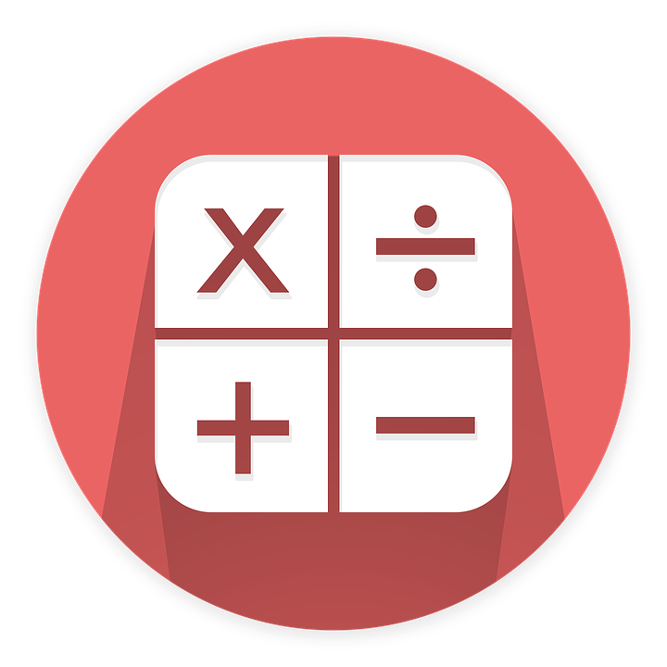
Maths
In year 7 Maths you do a range of topics. You have 8 lessons a fortnight and most of the class work is done individually although sometimes you will work in pairs. At the end of each topic, you will complete a yellow test to show how much you have understood. An example of some topics covered are: Algebra Fractions Angles Shapes Function machines BIDMAS (brackets, indices, divide, multiply, add, subtract).

Slide 5
DT
In year 7 DT, you rotate classes to try new subjects, you do things like cooking, graphics, engineering and 3D design. In DT you get chances to create and build things that you never have before. The rotations take place during year 7 and 8. In year 7 you will have a chance to take place in two subjects throughout the year and move on to the other two in year 8. In cooking you will have a chance to cook pasta salad, fruit salad, cookies, fruit muffins, shortbread, gingerbread, marble cake, cheese straws and cheese scones. In graphics you will design a chocolate bar wrapper and design a clock. In engineering you create and design a candle holder and in 3D design you create a wind chime based on the theme‘under the sea’.

Slide 6
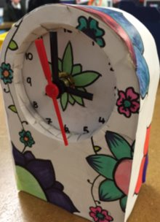
DT work
6

Slide 7
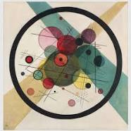
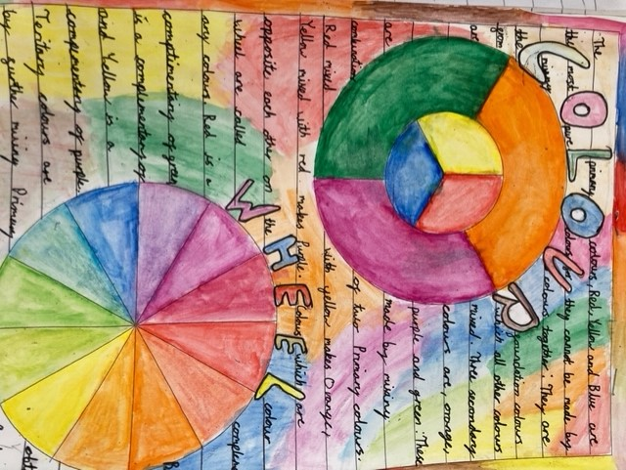
Art
In term 1 you will blow your teachers away with an amazing tonal page which is where you put together all of your knowledge on graduated tone. You will eventually get on to doing some amazing cutlery drawings and use tone to bring the piece to life.
When you get to term 2 you will explore colour theory, learning all about primary and secondary colours, you’ll begin to use your knowledge in several pieces throughout the year.
Art is a subject which is quiet and peaceful and allows you to creatively explore drawing which developing your skills.

Slide 8
Drama
In year 7 Drama you will be learning new techniques, skills and ways of expressing yourself to your audience. Drama is a great subject to grow your confidence and help you learn to work with a range of different people. The techniques you will be learning this year are:
Physical Theatre
Role on the wall
Freeze frame/ still image
Thought Tracking
Hot-seating
Role play
Cross Cutting
Forum Theatre
These skills will help you throughout your years at RWBA and help improve your acting skills as you grow.
In Drama the main rule is to be creative! Drama is really fun, but you need to make sure you always respect your peers and teachers whilst performing and rehearsing your performances.
If you enjoy Drama there is also a chance to join Drama club, which is on every Tuesday from 3-4pm. This club is great, and you can take part in whole school plays which are a great experience.

Slide 9
MFL
In modern foreign languages you will learn 1 of 3 languages - Spanish, French or German.
In MFL there will be 4 things you focus on
Speaking
Listening
Reading
Writing
For homework in MFL you will use a website called Memrise it will help you learn new words and extend your vocabulary
Sometime in your lesson you will play a game called blooket you will answer questions and win gold but people will steal it . If you have the most gold at the end of the game you will win.
It is really fun to learn a new language and it can be hard at times but the teachers help you step by step so you get more confident with it.

Slide 10
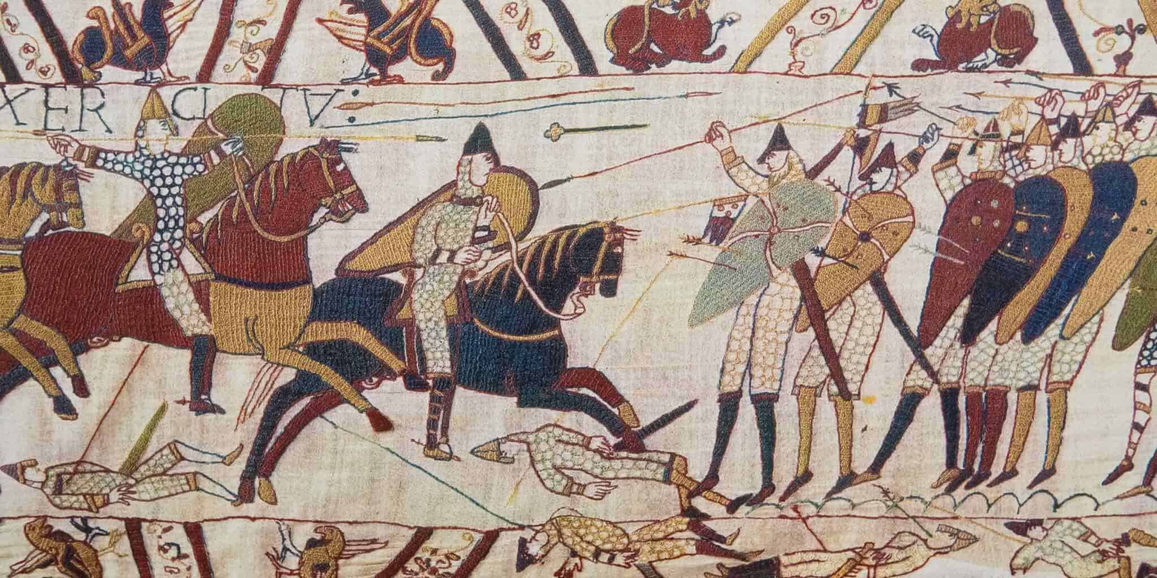
History
History teaches you about what happened in the past, such as The Battle of Normandy or The French Revolution. These are key points throughout History and in Year 7 you will start to learn about core history in term 1, then you will learn about the Norman Conquest in term 2. Term 3 will then be Medieval Times; Term 4 is the Islamic Golden Age. After that in Term 5 is The Tudors like King Henry the VIII and his 6 wives. Finally, will be the English Civil War at Term 6.
At the end of every term will be a test which is called a mini milestone but, is nothing to worry about because it is only to see your progress. Also, at the end of every year you will have an Assessment just like any subject to see how well you have remembered all the topics you have learned that year.

Slide 11
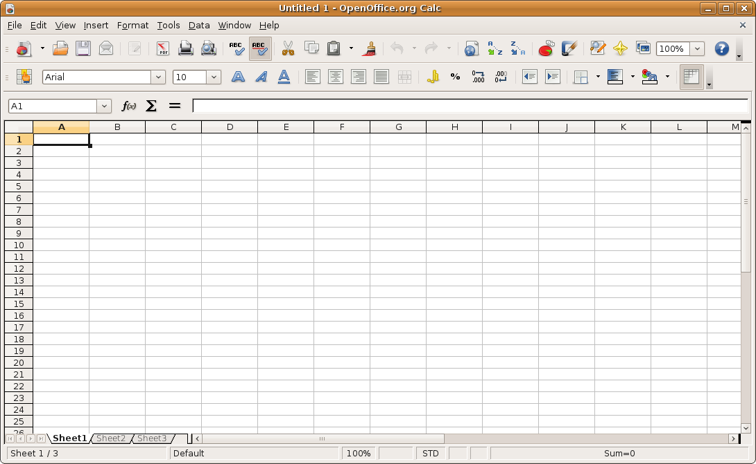
Computer Science
In ICT you will learn lots of new computing skills from making presentations on power point to learning about robotics and how to use spreadsheets. When learning about ICT your teachers will go through what you need to do step-by-step so it’s easier for students to understand and remember. These useful skills you learn are crucial for the future and will improve your learning throughout RWBA. In the computing rooms there are no drinks aloud near the computers for your, and your peer's safety. ICT is also about fun. Teachers will set fun activities during lessons such as, Kahoot, hour of code… and many more interesting websites you can visit.

Slide 12
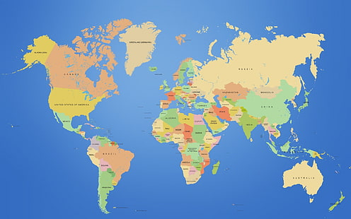
Geography
Geography is a fun subject. You get to learn about the world both locally and globally which is really interesting. In year 7 you get to go on a trip to Jubilee lake to help you make graphs and collect data. You often do graphs, biomes and microbiomes. Graphs are a great way to represent data and you will learn all about this. When looking at biomes you must look at animals' habitats and see how they have adapted to their environment. Microbiomes measure wind speed and directions which is really good.

Slide 13
Music
At RWBA, in our music lessons, we learn music theory and how to play instruments. In year 7 we start off with learning how to clap a rhythm in time. We use certain words to show how long a note lasts. During the time we are not playing instruments we learn keywords, the history and origin of music and listen to pieces. The best part is when we get to make music and play the instruments. In year 7 we learn keyboard violin and ukulele. On keyboard we learn piano techniques, pieces such as o when the saints, the last post and Christmas songs. On violin we start with a simple piece before moving on to twinkle twinkle little star. On the ukulele we learn chords and how to strum them. In terms of extra-curricular music, we have after school music clubs which you can get involved in.

Slide 14
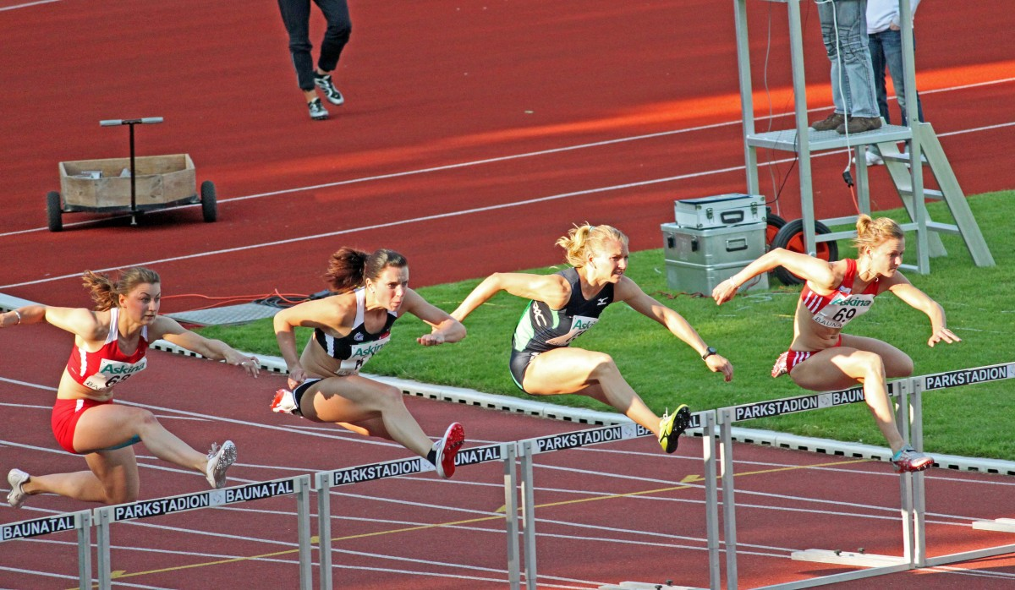
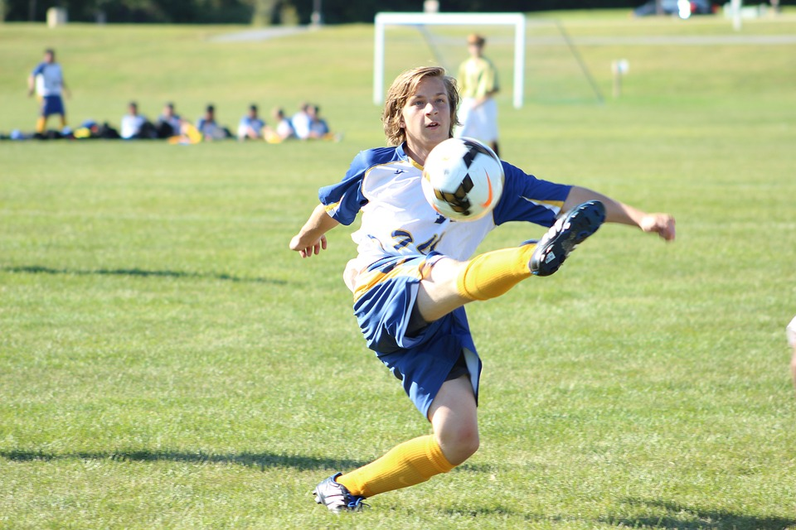
P.E
At RWBA, in our PE lessons, we learn the basics of certain games such as invasion games and bat and ball games, net and wall games, we also do aesthetics (Dance/gymnastics), health and fitness and OAA (outdoor adventure activities, orienteering). In invasion games we play rugby, football, netball handball, basketball dodgeball, bench ball and hockey. In our bat and ball lessons we play rounders cricket baseball and softball. In our net and wall games we play tennis, badminton, and volleyball. In our aesthetics lessons we learn a routine(gymnastics). In our Health and Fitness, we learn circuit training and in outdoor adventure activities we learn map reading and grid references; we also do hunt for objects around the school and filling a wordsearch by going to coordinates around the school and finding the name of the object at that location. There are extra-curricular PE clubs for a range of sports (this changes every term and can often depend on whatever is in season). For these clubs you get to participate in fixtures against other schools. These are picked based off attendance as well as the rep honours witch you get if you go to club for 75% of the days it is on.

Slide 15
Ethics & Philosophy
In EP you will look at deep questions about the world, religion and their stories.
In term 1 you’ll look at cosmology which is the study of the universe, this topic is really enjoyable and interesting.
Towards the end of the year, you’ll look at the topic of BAME (black, Asian minority ethnicities). This is an important thing to learn about as you’ll understand about their rights and the people who have stood up for that.
During your school year, you’ll learn about pilgrimage which also links to many topics in your History lessons.

Slide 16
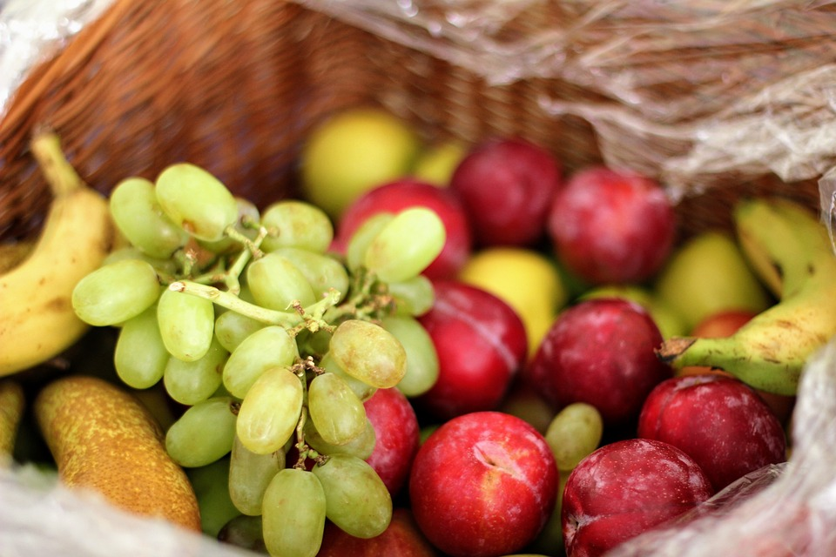
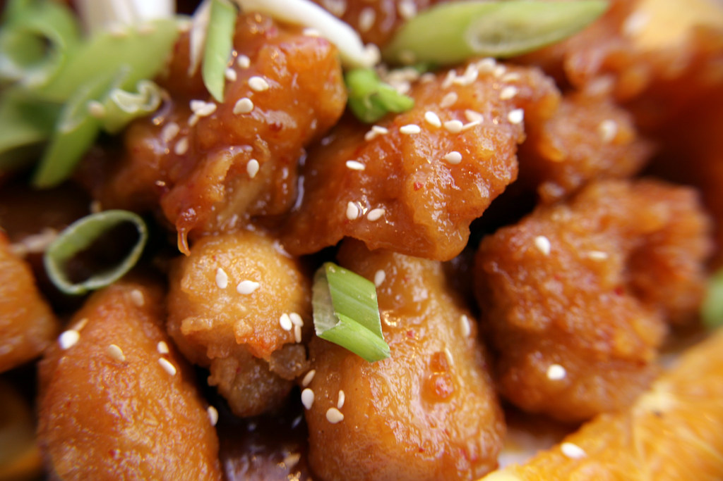
Lunch time
Lunch is when you can eat and play with your friends. Unlike break, lunch is a bit longer. It is 30 minutes long. An example of the school lunch menu is: Monday – Flat Bread Tuesday – Hotdogs/ Burgers Wednesday – Chicken nuggets and chips Thursday – Pizza/ Hotdogs Friday – Chicken wraps You can also have desserts like jam doughnuts, cookies, yoghurt, muffins, hot chocolate and ice cream. In year 7, you will get middle lunch which is 13:00-13:30.

Slide 17
Break time
Break time is a 20 minute long duration where you are able to buy food and hang out with your friends, during this time you should go to the toilet. When you are in Y7, the toilets are located under the DT stairs. You could also use this time to print out your work if you don't have a printer at home. But most of all, break time is a great time to catch up with your friends and have a break from your lessons. Break time is 11:10-11:30.

Slide 18
After school clubs
After school clubs happen form 15:00-16:00. These clubs vary from sports to learning different subjects. For Example: Art club Football club Robotics club Badminton club Lots of PE clubs Drama club Music Clubs Comic Club Science Clubs Chess Club And many more. All these clubs are completely free and so much fun. This is also a great way to make friends with people not in your class but with the same interests as you. However, the club you would have to pay for is rock climbing.

